Slide 1
UNIVERSITY OF BUEA | DEPT. OF COMPUTER ENGINEERING | CEF 440
TASK 4
System Modelling
& Design
Car Fault Diagnosis Mobile Application
Group 12 | Supervisor: Dr. Valery Nkemeni | Academic Year: 2025–2026

Slide 2
Table of Contents
01
02
03
Context Diagram
Data Flow Diagram
Use Case Diagram
External actors and system boundary
Internal processes and data stores
Actors, use cases and relationships
04
05
06
Sequence Diagrams
Class Diagram
Deployment Diagram
Dynamic interaction flows
Static structure and relationships
Physical architecture and nodes

Slide 3
01
Context Diagram
External actors, system boundary, and key data flows

Slide 4
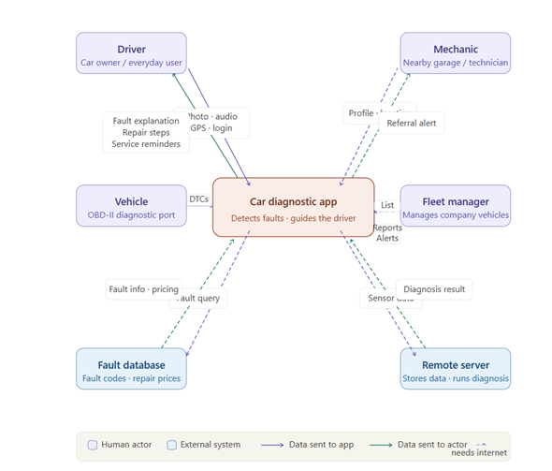
Context Diagram — System Overview (Level 0 DFD)

Slide 5
Context Diagram — External Actors
Human Actors
External Systems
Driver / Car Owner
Fault Code Library
Primary user. Sends photos, audio recordings, GPS location, and login credentials. Receives fault explanations, repair guidance, cost estimates, and service reminders.
External database of vehicle fault codes and repair price ranges. The app queries it to match OBD-II codes with fault descriptions and cost estimates. Updatable remotely.
Vehicle (OBD-II Port)
Remote Server
Not a person but treated as an actor. Transmits raw DTCs to the app via a Bluetooth or Wi-Fi OBD-II adapter. One-way flow — the app never writes to the ECU.
Backend server storing user data and running heavier diagnostic processing. The app sends sensor data to it and receives a structured diagnosis result in return.
Mechanic
Nearby garage or technician. Shares profile and location with the system. Receives referral notifications when a nearby user requests help.
Fleet Manager
Manages a company vehicle fleet. Sends list of vehicles to monitor. Receives fleet-level maintenance reports and alerts. All flows require internet.

Slide 6
Context Diagram — Design Implications
01
Driver is the Core Actor
02
Secondary Actors are Online-Only
More data flows connect to/from the driver than any other actor. The UX must prioritise a simple, non-technical interface.
Fleet manager and mechanic flows are all internet-dependent. These features can be deferred without breaking the offline core.
03
Vehicle is Read-Only
04
Two-Tier External Architecture
Data flows only FROM vehicle TO app. The app never writes to the vehicle ECU — this significantly simplifies OBD-II integration.
Fault database for local matching + remote server for heavy processing. Directly supports the hybrid offline/online design.

Slide 7
02
Data Flow Diagram
Level 1 DFD — internal processes, data stores, and key flows

Slide 8
Data Flow Diagram — Six Internal Processes
Verify User Identity
Capture Vehicle Data
P1
P2
Checks driver credentials against the User Accounts store before granting access. First step in every session.
Collects all raw inputs: OBD-II fault codes, photos, audio, and GPS. Performs initial code lookup in the fault library.
Analyse the Fault
Build Diagnosis Report
P3
P4
Core processing: combines OBD-II codes, image analysis, and sound analysis. Reads fault library and maintenance history.
Assembles final output: plain-language explanation, step-by-step repair guidance, and cost estimate from price list.
Record in History
Find Nearby Mechanic
P5
P6
Writes fault event to maintenance history, generates service reminders for driver, sends fleet reports to fleet manager.
Takes driver's GPS, searches mechanic directory, returns contact details, and sends referral notification to mechanic.

Slide 9
Data Flow Diagram — Five Data Stores
DS-01
User Accounts
Read by: P1
Driver profiles, login credentials, and vehicle registration details.
Written by: P1
DS-02
Fault Code Library
Read by: P2, P3
Catalogue of known fault codes, descriptions, and typical repair cost ranges. Updatable remotely without a full app release.
Written by: External
DS-03
Maintenance History
Read by: P3
All past fault events per vehicle. Supports predictive maintenance. Risk of read/write conflicts in offline-to-sync mode.
Written by: P5
DS-04
Mechanic Directory
Read by: P6
Registered mechanics with locations and contact info. Read-only by app. Requires internet to query.
Written by: External
DS-05
Repair Price List
Read by: P4
Estimated repair costs per fault type and geographic area. Read-only by app — maintained and updated externally.
Written by: External

Slide 10
Data Flow Diagram — Key Design Observations
P3 is the Most Complex Node
Analyse the Fault reads from two stores and receives data from the capture process. It is the most computationally intensive step and requires careful optimisation for low-end phones.
Read/Write Conflict Risk
Maintenance History is accessed by two different processes (P3 reads, P5 writes). Conflicts can occur when the app is used offline and later synchronises with the remote server.
P4 is the User-Facing Bottleneck
Build Diagnosis Report is the only process that produces visible output for the driver. All upstream processes exist solely to feed it. It must implement plain-language and bilingual requirements.
Mechanic & Fleet = Online-Only
The mechanic locator (P6) and fleet reporting (P5→Fleet Manager) flows are entirely dashed, confirming they are secondary features dependent on internet access.
Repair Price List is Read-Only
The Repair Price List is never written by the app itself. It must be maintained and updated externally — a database administration responsibility outside the app's scope.

Slide 11
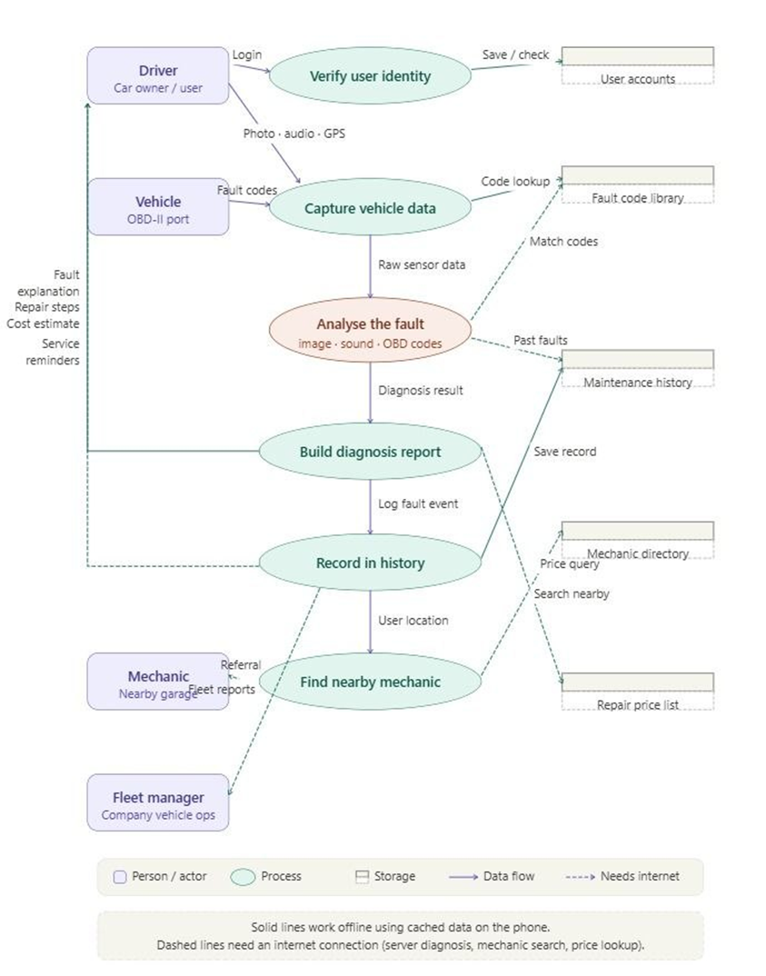
Data Flow Diagram

Slide 12
03
Use Case Diagram
Actors, functional boundaries, and use case relationships

Slide 13
Use Case Diagram — Actors Overview
Primary Actors
Secondary Actors (Systems)
Car Owner
AI Recognition Engine
CV pipeline for dashboard warning light detection.
Main user — initiates all 8 core diagnostic and management interactions with the system.
AI Audio Engine
Sound processing and acoustic fault classification.
Admin
Exclusive access to Update Fault Database (UC-07). Maintains the diagnostic knowledge base.
Video Platform
External service delivering repair tutorial content.
Local AI Engine
On-device offline inference (TFLite/ONNX).
Fault Database
Stores fault patterns, definitions, and repair guides.
Update Server
Hosts latest DB versions and ML model weights.

Slide 14
Use Case Specifications — All Seven Use Cases
ID
Use Case
Actor(s)
Description
UC-01
Register / Login
Car Owner
Auth flow — credentials hashed & validated, JWT returned, session initialised.
UC-02
Dashboard Warning Light Detection
Car Owner + AI Recog.
Capture image → CV pipeline → detect symbols → map urgency → display guidance.
UC-03
Engine Sound Analysis
Car Owner + AI Audio
Record PCM → STFT → CNN classifier → match fault patterns → suggest repairs.
UC-04
Online Support & Tutorials
Car Owner + Video API
Fault keywords → Video Platform query → embed native player → watch tutorials.
UC-05
Offline Diagnostic Functionality
Car Owner + Local AI
Network timeout → route to on-device model → preloaded DB → basic diagnosis.
UC-06
Manage User Profile & Vehicle
Car Owner / Guest
Register vehicle, view diagnostic history, enable maintenance notifications.
UC-07
Update Fault Database
AI System + Upd. Server
Background sync → version check → download delta → patch DB → notify user.

Slide 15
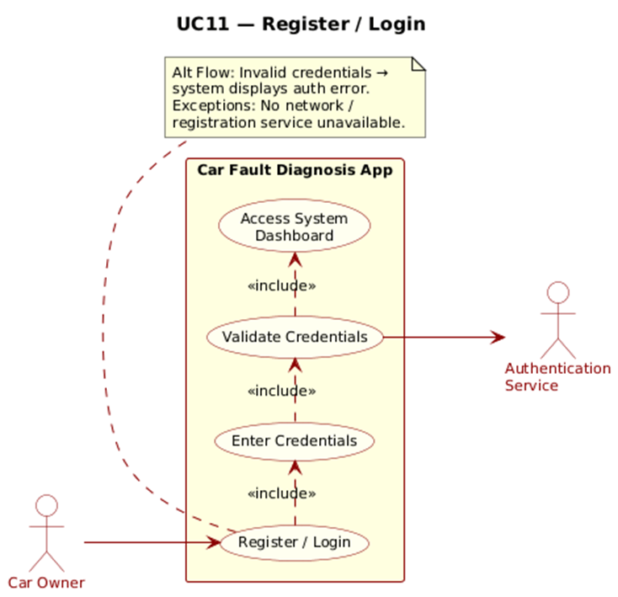
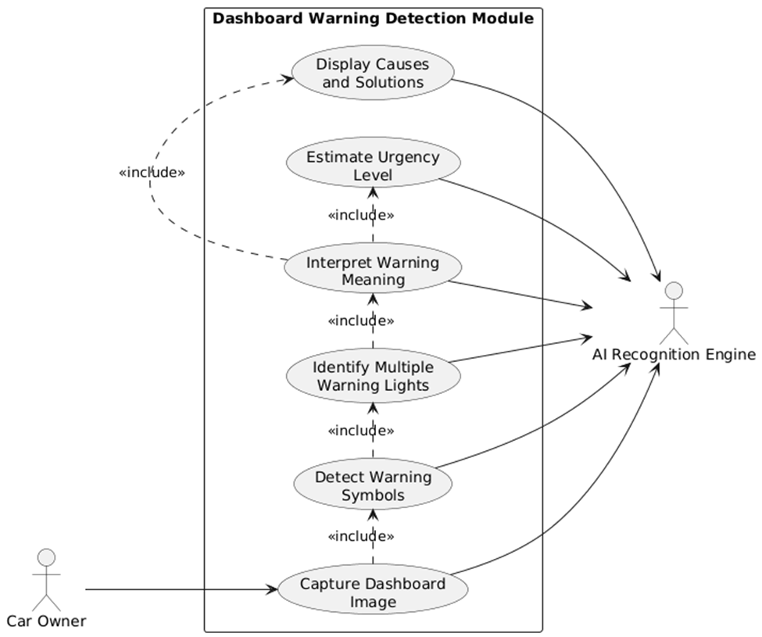
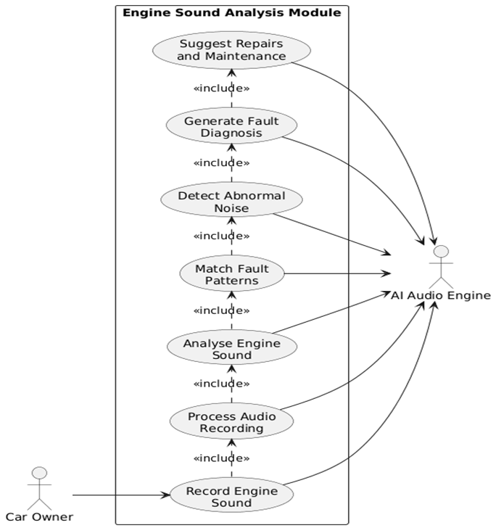
Use Case Specifications — All Seven Use Cases

Slide 16
04
Sequence Diagrams
Dynamic interactions — how and in what order components communicate

Slide 17
Sequence Diagrams — Six Scenarios
SD-01
Register / Login
3 alt flows: registration, login, invalid credentials. JWT token on success.
Car Owner → Mobile App → Auth Service → User DB
SD-02
Scan Dashboard Warning Lights
Image → normalise → object detection → classify → urgency + guidance.
Car Owner → Mobile App → AI Recognition Engine → Fault DB
SD-03
Record & Analyse Engine Sound
PCM audio → STFT → CNN → pattern match → confidence scores + repairs.
Car Owner → Mobile App → AI Audio Engine → Fault DB
SD-04
View Diagnosis Results
Both engines query DB independently → app compiles unified report.
Mobile App → AI Recog. Engine + AI Audio Engine → Fault DB
SD-05
Watch Repair Tutorials
Fault keywords → API search → embedded player. Offline: save link.
Car Owner → Mobile App → Video Platform API
SD-06
Offline Diagnosis
Network timeout → on-device model → local DB → basic report + alert.
Mobile App → Local AI Engine → Local Fault DB

Slide 18
SD-02 — Dashboard Warning Light Detection (Detail)
Car Owner
Mobile App
AI Recognition
Engine
Fault Database
1: Capture dashboard image
2: Forward image matrix
3: Normalise + run object detection
4: Query matched symbol IDs
5: Return meaning + urgency tier
6: Structured diagnosis result
7: Display fault explanation + urgency
ALT
[Offline / No Network]: Route all requests to Local AI Engine → run on-device quantised model → basic diagnosis → show 'limited mode' banner

Slide 19
SD-01 (Register/Login) & SD-06 (Offline Diagnosis) — Detail
SD-01: Register / Login
SD-06: Offline Diagnosis
1. Car Owner submits credentials (email + password)
2. Mobile App hashes credentials (bcrypt/SHA-256)
3. Auth Service validates against User Database
ALT [New User]: Create account → insert record
ALT [Existing User]: Verify hash → generate JWT
ALT [Invalid]: Return 401 → prompt retry
4. JWT token returned → session initialised
5. Router navigates to main Diagnostic Dashboard
1. App detects network timeout / no connectivity
2. Core intercepts → switches routing to Local AI Engine
3a. [Image path]: On-device CV model runs inference
3b. [Audio path]: On-device CNN model runs inference
4. Query Local Fault Database (cached SQLite)
5. Build basic diagnosis report
— Primary symbol IDs
— Generic mechanical system definitions
— Critical safety instructions
6. Show 'Limited Mode' banner
7. Queue full analysis for when connection restores

Slide 20
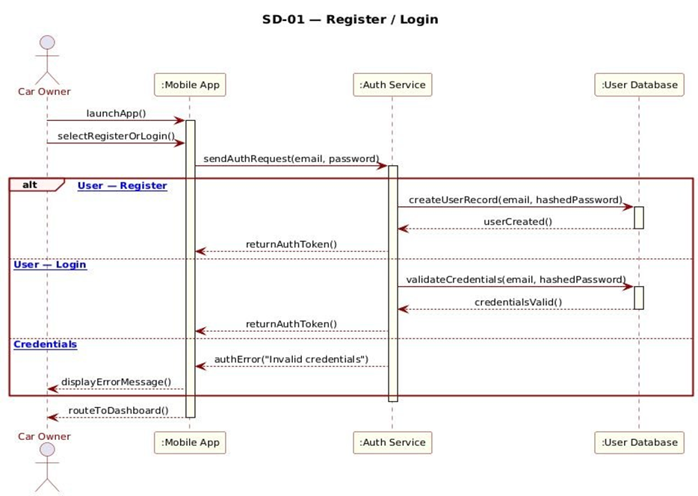
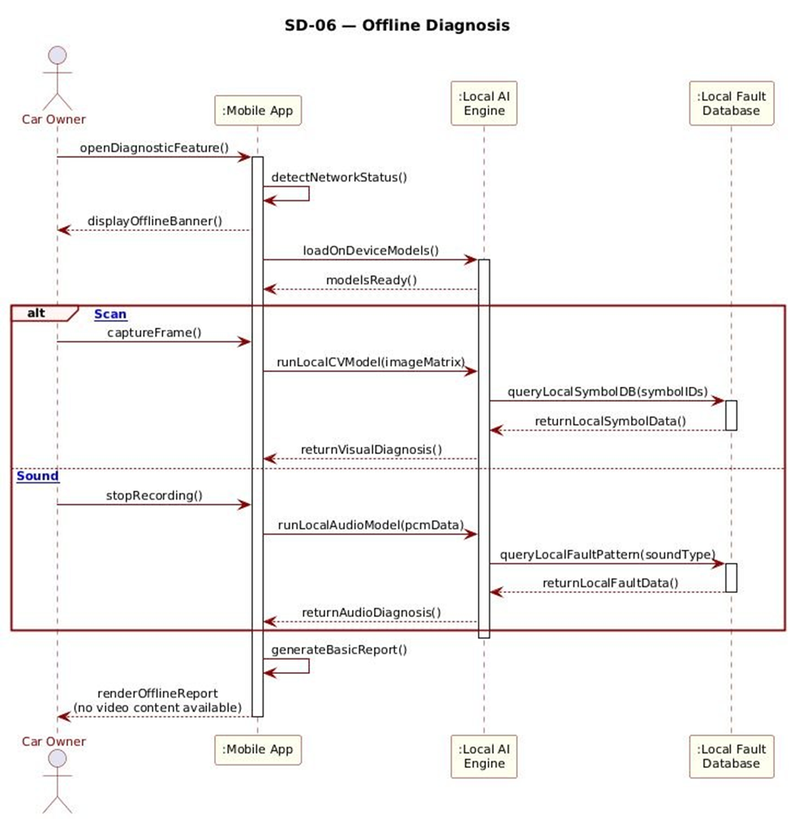
SD-01 (Register/Login) & SD-06 (Offline Diagnosis) — Detail

Slide 21
05
Class Diagram
Static structure — entities, attributes, methods, and relationships

Slide 22
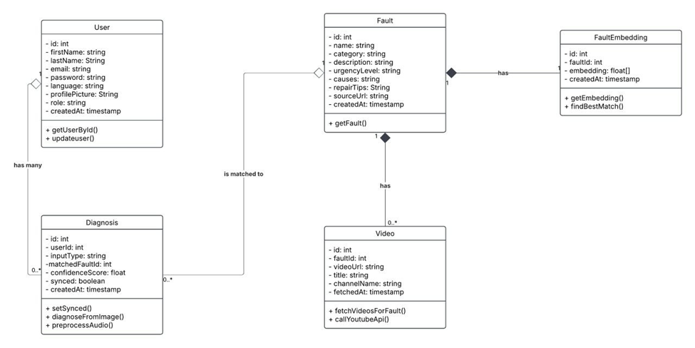
Class Diagram — Five Core Entities

Slide 23
Class Diagram — Relationship Summary & Design Rationale
Composition (◆)
Fault → FaultEmbedding
Multiplicity: 1 : 1
FaultEmbedding cannot exist without its parent Fault. Stores the 1408-dim Gemini multimodal embedding vector. Lifecycle is strictly dependent.
Composition (◆)
Fault → Video
Multiplicity: 1 : 0..*
Video records have no independent existence outside their parent Fault. A fault may have zero or more associated YouTube repair videos.
Aggregation (◇)
User → Diagnosis
Multiplicity: 1 : 0..*
Hollow diamond: Diagnosis records CAN exist independently of a User (supports guest users). A user may have many diagnoses or none.
Association
Diagnosis → Fault
Multiplicity: 0..* : 1
Every Diagnosis event is matched to exactly one Fault. Loose coupling allows diagnoses to be queried and persisted independently.

Slide 24
06
Deployment Diagram
Physical architecture — nodes, artifacts, and communication paths

Slide 25
Deployment Diagram — Physical Architecture Overview
Mobile Device (Android/iOS)
Backend Server
YouTube API
HTTPS
«artifact»
«artifact»
External video platform
Repair tutorial content
YouTube Data API v3
carfault_app
REST API Service
HTTPS
Main Application
Middleware & sync handler
«artifact»
carfault_model.tflite
SQL
OBD-II Adapter (opt.)
TensorFlow Lite Model
Database Server
Bluetooth
Optional Bluetooth device
Read-only DTC access
Complements on-device AI
«artifact»
«artifact»
local_cache.db
Fault Database
SQLite Local Cache

Slide 26
Deployment Diagram — Architectural Strengths
Offline-First Capability
Fast On-Device Inference
✓
✓
local_cache.db + TFLite model enable full diagnostics with zero internet access. Core use case never blocked by connectivity.
TensorFlow Lite quantised model minimises latency. Mobile-friendly AI execution runs even on low-end Android/iOS devices.
Cloud Synchronisation
Optional OBD-II Integration
✓
✓
Backend + database server keep fault knowledge current and sync full diagnosis history when connectivity is restored.
Bluetooth adapter adds a richer diagnostic channel without being mandatory. App fully operational without it.
Hybrid Architecture
Decoupled External Services
✓
✓
Smartphone handles core work locally. Backend manages heavy processing, central storage, and cross-device sync.
YouTube API integration provides rich tutorial content without hosting costs. Easily swapped or extended without core changes.

Slide 27
Summary
Six diagrams. One coherent system.
Context Diagram
6 external actors · 2 categories · 10 key data flows · offline/online split
Data Flow Diagram
6 internal processes · 5 data stores · hybrid architecture confirmed
Use Case Diagram
9 use cases · 2 primary actors · 6 secondary systems · 7 specifications
Sequence Diagrams
6 dynamic flows — auth, visual, acoustic, unified, tutorials, offline fallback
Class Diagram
5 core entities — Fault, FaultEmbedding, Video, User, Diagnosis
Deployment Diagram
5 nodes — Mobile Device, Backend, Database, YouTube API, OBD-II Adapter
Group 12 · CEF 440 · University of Buea · Academic Year 2025–2026

